Slide 1
ANALYSIS OF CO-AUTHORSHIP NETWORK IN GOOGLE SCHOLAR
Aviral Sharma
20BCE2918

Slide 2
Introduction
Scientific collaboration is one of the main reasons for the advancement of human beings in various frontiers of knowledge. When researchers work together, they create a network among themselves called co-authorship network. Thus, a co-authorship network is a network with researchers as nodes and the links tying them together is the co-authorship. Two researchers are connected if they have worked on same research paper. It is one of the most used methods to study scientific collaboration since the publication of scientific paper is very well documented through the history. Another method to study scientific collaboration is citation network where the nodes are the scientific papers and they are linked if one paper has cited the other one.
It is important to study these co-authorship networks for multiple reasons. It is extremely useful to determine the influence of a particular individual on a field of study. Many scenarios can arise; an organization might want to know which research candidate performs better in a particular field, a staff enrollment panel may want to rank the competitors based on their past records of teamwork and collaboration, a student might want to choose the best advisor and so on. These cases require proper metrics, other than citation metrics like h[1]index, g-index, number of citations, which can be evaluated using co-authorship network analysis.
To analyze co-authorship network in this project, Google Scholar is used in this project. Google Scholar is a web search engine that indexes the full text or metadata of scholarly literature. Authors publish their academic papers along with their co-authors on Google Scholar, which allows the extraction of a co-authorship network. The detail of an author is stored as their Google Scholar author profile. Using web scraping, the co-authors of a particular author can be extracted, and a network can be built, which can then be used to perform various Social Network Analysis (SNA) techniques.

Slide 3
Dataset used
To analyze co-authorship network in this project, Google Scholar is used in this project. Google Scholar is a web search engine that indexes the full text or metadata of scholarly literature
Instead of choosing an available dataset, the required data is obtained through scraping the Google Scholar website to get continuous actors in the network.

Slide 4
Literature Survey
[1] A.L Barabási, H Jeong, Z Néda, E Ravasz, A Schubert, T Vicsek, Evolution of the social network of scientific collaborations, in Physica A: Statistical Mechanics and its Applications, Volume 311, Issues 3–4, 2002, Pages 590-614, ISSN 0378-4371,
https://doi.org/10.1016/S0378-4371(02)00736-7.
This paper studies the collaboration network among scientists who published journals in mathematics and neuroscience over a period of eight years from 1991 to 1998 using two major approaches. First, it uses direct measurements to discover the method by which collaboration network evolves over time. Second, a model based on the parameters found through direct measurements is constructed that provides the predictions required to explain many results. The centrality used by them were only betweenness and closeness .

Slide 5
[2] Yang Chen, Cong Ding, Jiyao Hu, Ruichuan Chen, Pan Hui, and Xiaoming Fu. 2017. Building and Analyzing a Global Co-Authorship Network Using Google Scholar Data. In Proceedings of the 26th International Conference on World Wide Web Companion (WWW '17 Companion). International World Wide Web Conferences Steering Committee, Republic and Canton of Geneva, CHE, 1219–1224. DOI:
https://doi.org/10.1145/3041021.3053056
In this paper, the authors have used Google Scholar as a platform to collect data of authors and built a global co-authorship network of about 402.39K authors. They applied various metrics of social network analysis such as degree, clustering coefficient and PageRank to study the co-authorship network. By building this global network, they were able to find many unique features of the network. They also found that there is a good correlation between position in the network and h-index.

Slide 6
[3] M. Fujita, H. Inoue and T. Terano, "Searching Promising Researchers through Network Centrality Measures of Co-author Networks of Technical Papers," 2017 IEEE 41st Annual Computer Software and Applications Conference (COMPSAC), Turin, Italy, 2017, pp. 615-618. doi:
10.1109/COMPSAC.2017.205
The authors in this paper propose that betweenness centrality can be used as an effective metric to search for promising young researchers. They assumed that better researchers possess higher betweenness centrality and that the betweenness centrality of promising scientists will grow over time. They used the data from Japan Science and Technology Agency (JST) to detect growing betweenness. They also showed that the Research Fellows from Japan Society for the Promotion of Sciences (JSPS) who had been evaluated as promising researchers had a growing betweenness centrality.

Slide 7
[4] Perianes-Rodríguez, A., Olmeda-Gómez, C. & Moya-Anegón, F. Detecting, identifying and visualizing research groups in co-authorship networks. Scientometrics 82, 307–319 (2010).
https://doi.org/10.1007/s11192-009-0040-z
This paper suggests a method to detect, identify and visualize research groups in a coauthorship network. Research groups are scientists that collaborate on research and share resources and other materials, but not necessarily in the same organization. The groups are detected based on factorial analysis of raw data matrix and similarities in the choice of coauthors. These groups are then visualized using coloured diagrams. They referred to nine Carlos III University of Madrid developments for data and findings for the Communication Technologies Department for the method.

Slide 8
[5] Mark EJ Newman, Coauthorship networks and patterns of scientific collaboration in Proceedings of the national academy of sciences 101 (suppl 1), 5200-5205
https://doi.org/10.1073/pnas.0307545100
Newman in his paper has collected data of authors from three areas- biology, physics and mathematics. He analysed the co-authorship network among the authors to answer a large number of questions including the number of papers an author writes, average number of coauthors, distance between collaborators and the temporal evolution of networks. He found out that biology contains the greatest number of authors and papers published, with higher number of collaborations as compared to physics and mathematics. He also evaluated the distance between authors, associativity, strength of collaboration, clustering coefficient, betweenness centrality and other metrics.

Slide 9
[6] Kalhor, Ghazal, Amin Asadi Sarijalou, Niloofar Sharifi Sadr, and Behnam Bahrak. "A new insight to the analysis of co-authorship in Google Scholar." Applied Network Science 7, no. 1 (2022): 21
The authors use social network analysis to analyze the co-authorship patterns and identify the most influential researchers and research groups. They find that co-authorship is a common practice among Iranian researchers, and the size of research groups is increasing over time. They also find that the number of co-authors has a positive correlation with citation rates, indicating that collaboration and teamwork can have a positive impact on research impact.
Overall, the study provides valuable insights into the co-authorship patterns in Google Scholar and the impact of collaboration on research outcomes. The findings have important implications for researchers, institutions, and policymakers who seek to improve the quality and impact of research.

Slide 10
[7] Li, X., Wang, Q., Li, Y., Liang, X., & Chen, X. (2020). Co-authorship analysis of highly cited publications in Library and Information Science: A case study of China. Scientometrics, 123(2), 841-856.
The study found that co-authorship is a common practice among Chinese researchers in LIS, and the size of research teams has been increasing over time. The authors also found that the most productive and influential researchers tend to collaborate more frequently and with a diverse range of partners. Furthermore, the study identified the most productive and influential institutions in LIS research in China, as well as the patterns of international collaboration in the field.
Overall, this study provides important insights into the co-authorship patterns and collaboration practices in LIS research in China, and highlights the key players and institutions in the field. It also has implications for researchers, institutions, and policymakers who seek to improve the quality and impact of research in this field.

Slide 11
[8]Abramo, G., D’Angelo, C.A., & Di Costa, F. (2018). Co-authorship and bibliographic coupling network effects on citations. Journal of Informetrics, 12(1), 117-131.
The study found that co-authorship and bibliographic coupling have a positive and significant impact on citation rates, indicating that collaboration and interdisciplinarity are important factors in scientific research impact. The authors also found that the effect of bibliographic coupling on citation rates is stronger than that of co-authorship, suggesting that citation links between papers are more important than authorship links.
Overall, this study provides important insights into the relationship between co-authorship, bibliographic coupling, and citation rates, and highlights the importance of collaboration and interdisciplinary research in scientific impact. It also has implications for researchers, institutions, and policymakers who seek to improve the quality and impact of research in various fields.

Slide 12
[9] Batista, P.D., Campiteli, M.G., & Kinouchi, O. (2006). Is it possible to compare researchers with different scientific interests?. Scientometrics, 68(1), 179-189.
The study used a sample of 1,000 researchers from different scientific fields and analyzed their co-authorship networks. The authors found that the CAS method is able to compare researchers from different fields and provide a more accurate evaluation of their scientific output and impact than traditional citation-based methods.
Overall, this study provides an innovative approach to comparing researchers with different scientific interests based on their co-authorship patterns. It has important implications for researchers, institutions, and policymakers who seek to improve the accuracy and fairness of research evaluation and funding allocation.

Slide 13
[10] Glänzel, W., & Schubert, A. (2005). Analysing scientific networks through co-authorship. In Handbook of quantitative science and technology research (pp. 257-276). Springer Netherlands.
The authors provide examples of co-authorship analysis in various scientific fields, including bibliometrics, social network analysis, and science policy. They also discuss the strengths and limitations of co-authorship analysis, as well as its potential applications in research evaluation, collaboration analysis, and knowledge mapping.
Overall, this chapter provides a comprehensive and informative overview of co-authorship analysis as a tool for studying scientific networks. It is a valuable resource for researchers, students, and practitioners interested in bibliometrics, social network analysis, and science policy.

Slide 14
Limitations of Existing Models
1. The proper study of the communities in co-authorship networks, the flow of information among various actors, evolution of the network and other important factors are inadequate.
2. The papers are restricted to a specific field of study and are not common for all the researchers.
3. The use of the information obtained from the network analysis is still undetermined.
3. The studies are yet to be compared at scientific, regional, national and international levels of the network.

Slide 15
Proposed System
Web Scraping: Instead of choosing an available dataset, the required data is obtained through scraping the Google Scholar website to get continuous actors in the network. It also allows the control of the number of actors in the group and size of the group. This can be done by recognizing the correct HTML tag attribute that contains the label of the author.
Creating Network and Subnetwork After data collection through web scraping: The next step is to develop the network by finding the connections between the nodes using a network generator. Further, the data is pruned and the weak nodes are removed to generate a sub network.

Slide 16
Proposed System
3. Network Analysis: The network analysis is performed by calculating various centrality measures that include degree centrality, betweenness centrality, closeness centrality and eigenvector centrality. PageRank is an example of eigenvector centrality. PageRank was one of the algorithms used by Google to rank its websites. PageRank calculations require a few passes called emphases. These measures are calculated for the network created for each of the node.
4. Result Visualization :The final co-authorship network is visualized using NetworkX module so that it becomes easy for us to observe patterns in the network.

Slide 17
Scraping Engine and Network Analysis Architecture
Scholar’s URL
Scraping Engine
Extract name and URL
Store in
a list
Maximum
number of nodes
Add corresponding edges in the graph
No
Maximum
number of nodes
exceeded ?
Yes
Calculate
Centrality measures
Visualize the network
Co-authorship Network

Slide 18
Centrality Measures
Degree Centrality 𝐶𝐷(𝐺) = ∑ [𝐶𝐷(𝑣 ∗) − 𝐶𝐷(𝑣𝑖)] /(|𝑉| 𝑖=1 |𝑉| 2 − 3|𝑉| + 2 )
Closeness Centrality 𝐶(𝑢) = 1 /∑𝑦 𝑑(𝑢, 𝑦)
Betweenness Centrality 𝐵(𝑢) = ∑ 𝜎𝑠𝑡(𝑣)/ 𝜎𝑠𝑡
Page Rank 𝑃𝑅(𝑢) = (1 − 𝑑) + 𝑑 × ∑ 𝑃𝑅(𝑣) /𝑁(𝑣)

Slide 19
Implementation
The project was implemented on VS Code using Python. The details of the modules used are presented here.
• Programming Language: Python
• Platform: Vs code
• Modules used:
o matplotlib
o networkx
o pandas
o requests
o BeautifulSoup
o seaborn
o defaultdict
o urllib3

Slide 20
Implementation
The main libraries used in the project are
NetworkX is a python library used to create, analyze and manipulate networks. It is used to make networks in various formats and visualize them. It also has built-in methods to perform various calculations on a network.
matplotlib is a python library to create various types of visualizations such as graphs and plots.
seaborn is another python library to visualize data using various plots. It is based on matplotlib and contains many additional attractive formats.
Beautiful Soup is used to parse the data out of HTML and XML files. It can be used to search the contents of tags in the files with ease.
The variable scholar is assigned the url of the author and the number of nodes to be considered was set to 100

Slide 21
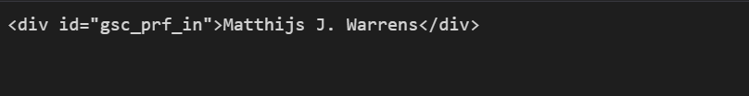
Web Scrapper: The name of the author is situated in a div tag with id “gsc_prf_in”.

Slide 22
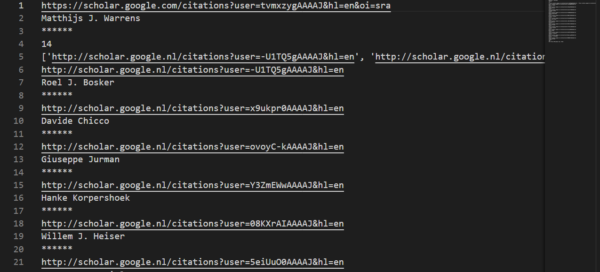
The list of the coauthors is stored in an anchor tag <a> with tabindex value of -1.

Slide 23
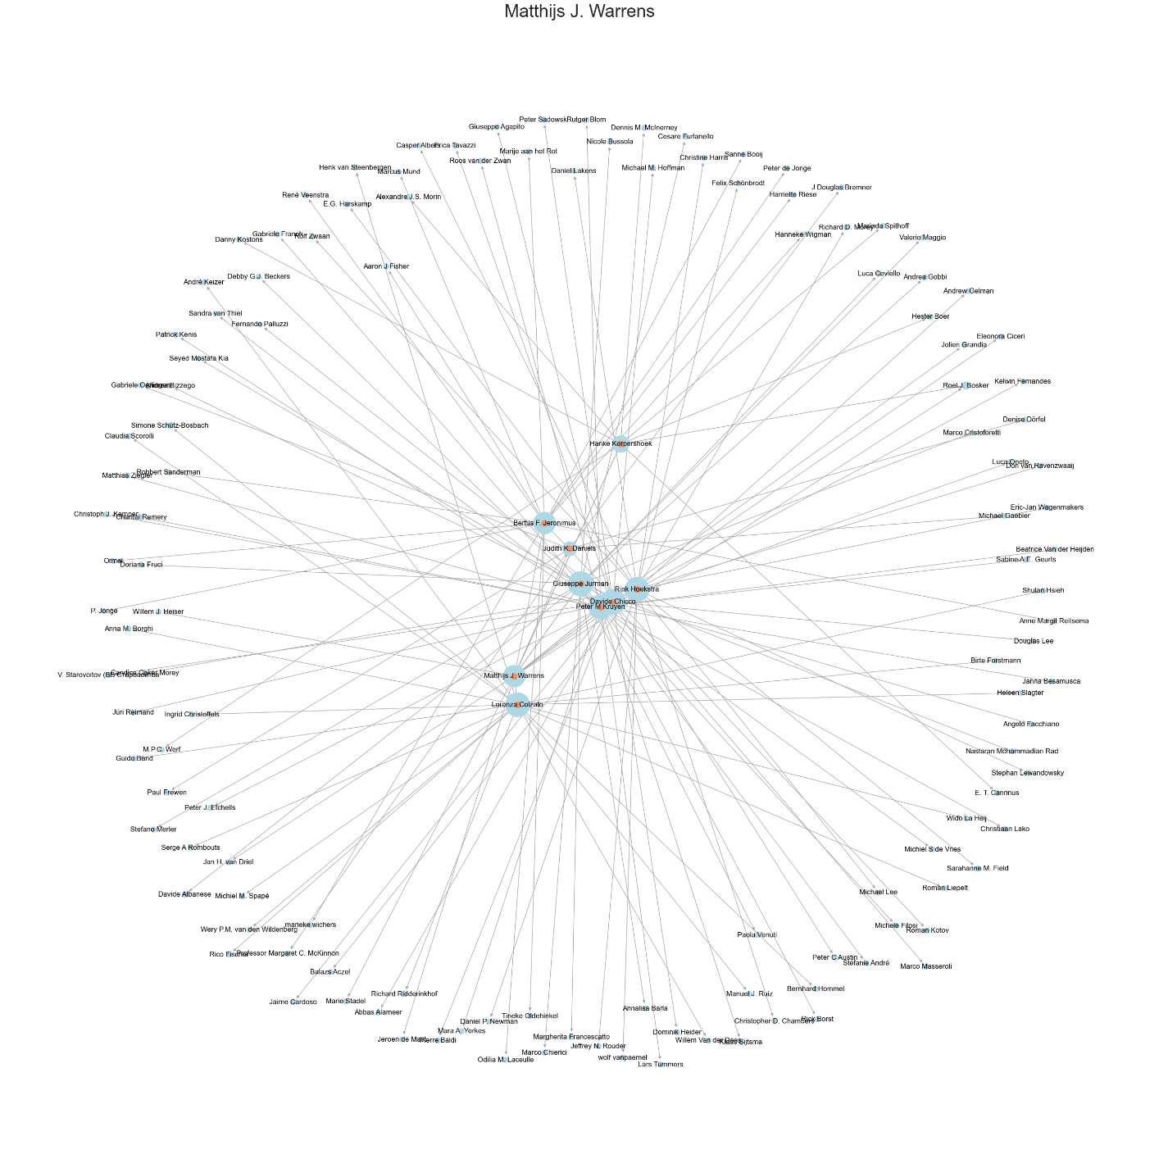
RESULTS AND DISCUSSION
Upon running the code, the network of 204 nodes was made with 100 nodes considered for the analysis. The network is visualized and presented in the figure below.

Slide 24
RESULTS AND DISCUSSION
The degree distribution is presented in a histogram. Most of the modes have a degree of 1.The important subnetwork is also created by finding the nodes which are more prominent in the network. The resting subnetwork is also visualized .

Slide 25
RESULTS AND DISCUSSION
Similarly, histograms were made for the degree centrality, closeness centrality and betweenness centrality.
The average values of the centrality measures are given here.
Average Degree Centrality: 0.0155887230514095
Average Closeness: 0.017139364890078987
Average Betweenness: 0.0003893099607345318

Slide 26
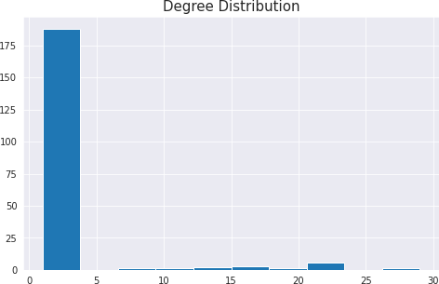

Slide 27
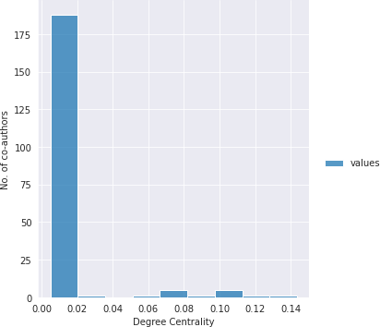

Slide 28
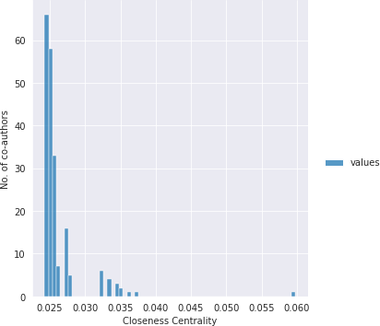

Slide 29
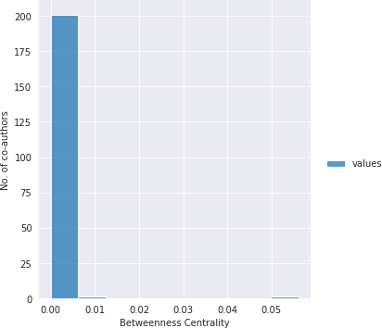

Slide 30
Conclusion
From this project, the network of co-authors was constructed and analyzed. The values of degree centrality, closeness centrality, betweenness centrality and pagerank was calculated for each of the nodes and a subnetwork of the most important actors was constructed. From this study, the uses of co-authorship network can be realized and the information obtained can be employed in various fields.
The system made in this project can be improved in many ways. The current implementation only records the top twenty co-authors of a person. To get the list of all co-authors, other methods have to be devised or another scrapper must be used. The number of nodes can be increased to make the network bigger and analyze the communities that are formed in the network. The evolution of network over time is also not considered in this project and can be an interesting addition to this project, providing useful insights in the network.

